Slide 1

2023
Compare Node.js Deno Bun
Team numbers:
Rafael Guias, 拉法.吉亚, b00378786
Yaowu Zhang, 张耀午, b01656014
Ziyi Xia, 夏子轶, b01655286
Zhan Jiang, 蒋湛, b01656074

Slide 2
Team Numbers
Rafael Guias
Responsible for searching Deno information
Yaowu Zhang
Responsible for summarizing information and creating a PowerPoint presentation.
Ziyi Xia
Responsible for searching Bun information
Zhan Jiang
Responsible for searching Node.js information

Slide 3
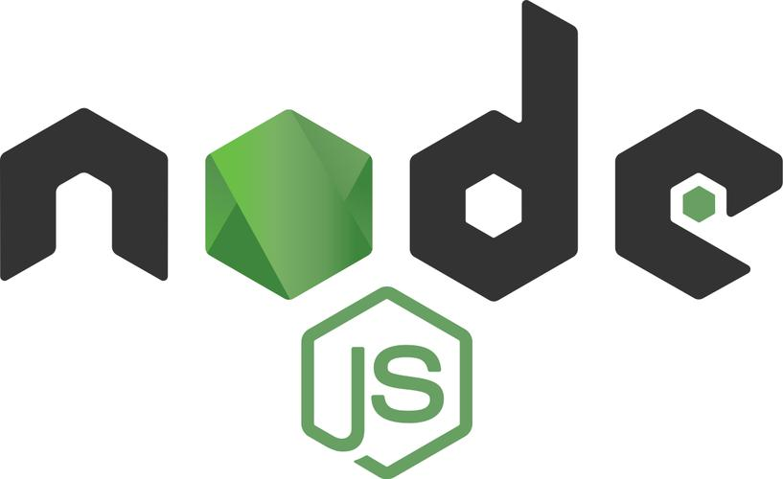


CONTENTS
What is it
Node.js Deno and Bun
Advantage and Disadvantage
Node.js Deno and Bun
User distribution
Node.js Deno and Bun
Summary
Node.js Deno and Bun

Slide 4
01
What is it?

Slide 5
What is Node.js
Before Node.js, JavaScript could only run in the browser and be used as a web script to add some effects to a web page or to communicate with the server. With Node.js, JavaScript can be used directly on the computer without a browser, just like any other programming language.
Node.js is not a new programming language or a JavaScript framework, it is a JavaScript runtime environment that supports the execution of JavaScript code. In programming terms, Node.js is a JavaScript runtime.

Slide 6
What is Deno
Deno is a modern JavaScript and TypeScript runtime environment that was created by Ryan Dahl, the original creator of Node.js. Deno is designed to address some of the shortcomings and security concerns of Node.js while providing a runtime for running server-side and command-line JavaScript and TypeScript applications.

Slide 7
What is Bun
Bun is a JavaScript runtime, package manager, test runner bundler built by Zig programming language. It was designed by Jarred Sumner. The purpose to design it is as a drop-in replacement for Node.js.
JavaScript (or, more formally, ECMAScript) is just a specification for a programming language. Anyone can write a JavaScript engine that ingests a valid JavaScript program and executes it. The two most popular engines in use today are V8 (developed by Google) and JavaScriptCore (developed by Apple). Both are open source. Bun uses JavaScriptCore as the JavaScript engine, but Node.js and Deno both use V8 as the JavaScript engine.

Slide 8
02
Advantage and Disadvantage

Slide 9
Advantage and Disadvantage of Security Model
Node.js:
Due to the widespread use of the Node.js ecosystem, there can be threats from insecure third-party modules and packages.
Deno:
One of the most significant differences between Deno and Node.js is its security model. Deno has a built-in security system that provides fine-grained control over file access, network access, and other potentially dangerous operations.
By default, Deno runs with secure permissions, meaning it doesn't have access to the file system or network unless explicitly granted by the user. Permissions are granted using command-line flags, and they can also be managed programmatically.
Bun:
One of Bun's design goals is to serve as an alternative to Node.js, so its security characteristics may inherit some features from Node.js.

Slide 10
Advantage and Disadvantage of TypeScript Support
Node.js:
Node.js doesn't natively support TypeScript, but you can write Node.js applications in TypeScript and then use the TypeScript compiler to transpile them into JavaScript.
Deno:
Unlike Node.js, Deno doesn't use a package manager like npm. Instead, it uses ES modules for importing dependencies directly from URLs. You can import modules from URLs, and Deno will fetch and cache them locally.
Bun:
TypeScript support in Bun depends on its configuration and usage. It may be used to run TypeScript applications, but its TypeScript support might not be as direct or comprehensive as Node.js and Deno.

Slide 11
Advantage and Disadvantage of Package Manager
Node.js:
Node.js usually uses npm as its package manager. npm is a widely adopted package manager with a large number of open source packages and modules. It supports easy-to-use command line tools to install, update, and manage dependencies.
Deno:
Deno comes with a standard library that provides a set of core modules for common tasks, such as file I/O, HTTP, and encoding/decoding data. These modules are part of the Deno runtime, so you don‘t need to install them separately.
Bun:
Bun's package manager is affected by its configuration and usage. The specific package management method may vary depending on the needs of the project.

Slide 12
Advantage and Disadvantage of Standard Library
Node.js:
Node.js has an extensive standard library, including core modules such as file system, network, stream processing, encryption, HTTP, etc.
Deno:
Deno comes with a standard library that provides a set of core modules for common tasks, such as file I/O, HTTP, and encoding/decoding data. These modules are part of the Deno runtime, so you don't need to install them separately.
Bun:
Bun's standard library depends on its configuration and purpose. It may inherit some standard library functionality from the Zig programming language.

Slide 13
Advantage and Disadvantage of Built-in Tools
Node.js:
Node.js uses npm as its package management tool. npm is a powerful ecosystem with a large number of third-party modules and tools.
Deno:
Deno comes with a built-in command line tool that makes running and managing Deno applications easier.
Bun:
Bun is a module packaging tool that can package multiple modules into one file to improve performance and loading speed.

Slide 14
Advantage and Disadvantage of Stability
Node.js
Node.js offers proven performance, powering 2.1% of the world’s websites. This is a known quantity and a product that a large number of projects rely on. If you do have a problem, there's a good chance someone knows how to fix it.
Deno
Version 1.0 of Deno was released in May 2020 and is considered the first stable version. However, adoption has been slow, perhaps because there is no “user-perceived” differentiator to win over developers’ collective support. Since the release of version 1.0, it has made great strides in improving the developer experience while maintaining stability with each release so that developers can upgrade with little impact.
Bun
Bun has version 1.0 released in September 2023. As a result, its stability and coverage of the Node.js core API has improved significantly since its beta release, and it's likely to continue as more and more people in the community look to adopt it in their projects .

Slide 15
03
User distribution

Slide 16
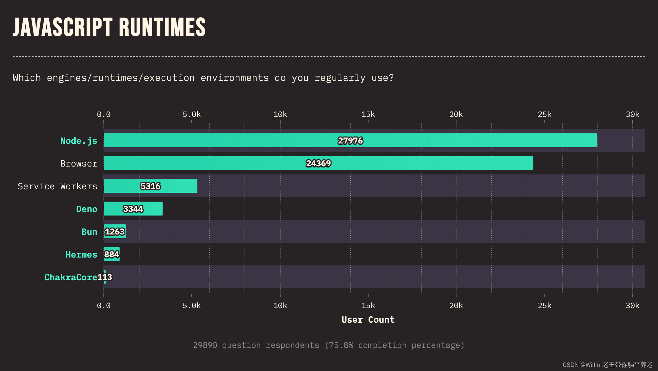
The results of the latest 2022 survey also paint Node.js as the clear leader, with Deno trailing at 5.3k votes and Bun receiving around 1.2k votes. This is to be expected, and it will be interesting to see how these numbers change in the upcoming 2023 survey results. Maybe we will see some new trends with Deno and Bun.

Slide 17
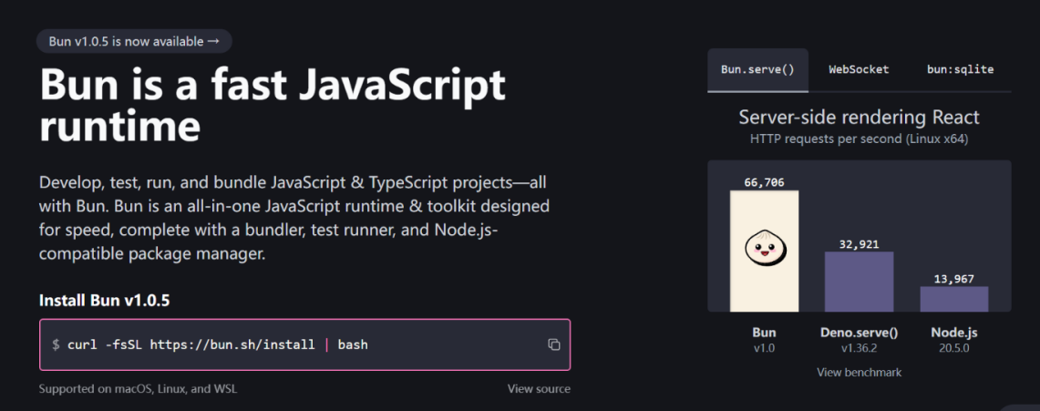

Slide 18
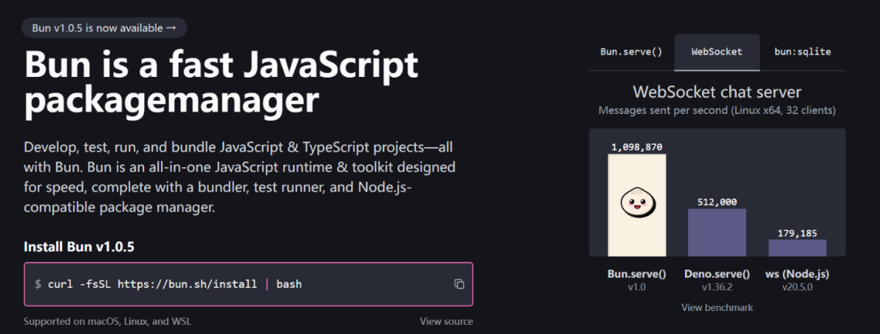

Slide 19
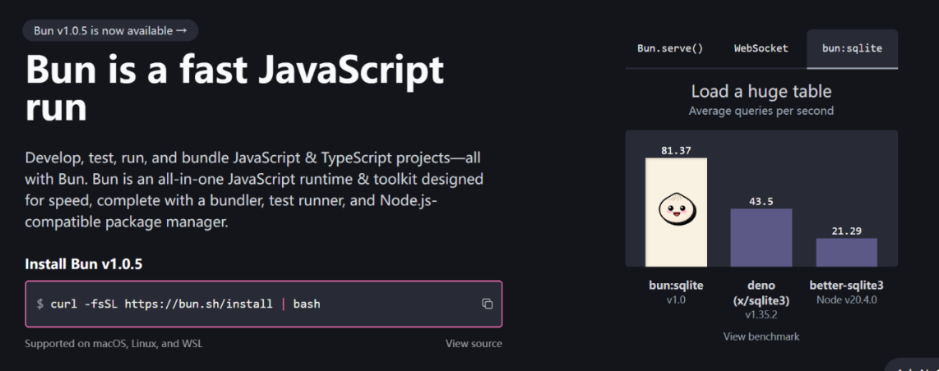

Slide 20
04
Summary

Slide 21
Summary
Choosing between Deno, Bun, and Node.js largely depends on your project requirements and your personal preferences.
If maturity, a large ecosystem, and community support are your top priorities, Node.js remains a strong contender.
If you're looking for a modern, safe-by-default runtime with best-in-class developer experience and continued maturation, look no further than Deno.
If you want to combine the best of Node.js and Deno with an emphasis on cutting-edge performance and a great developer experience, Bun may be your answer.

Slide 22
Reference
"C Standard Library Functions - Standard Library Function Reference Manual." Programming Technology Website, http://c.biancheng.net/view/9338.html.
"How to Learn Programming Languages: Best Practices." 51CTO, https://www.51cto.com/article/769280.html
"How to Improve Programming Skills?" Zhihu Column, https://zhuanlan.zhihu.com/p/655719481..
"bun.sh."
https://bun.sh/.
"Bun." Wikipedia,
https://en.wikipedia.org/wiki/Bun.

Slide 23
THANK YOU
谢谢

